Slide 1
Tutorial 2 Data Structure and Algorithms
2020-01-17
Morteza Alipourlangouri
alipoum@mcmaster.ca

Slide 2
Agenda
SVN
Installation
Basic features
Algorithm Complexity
Big-Oh notation, Big-Omega notation, Big-Theta notation
Tilde Approximation
Order of Growth
Coding exercise (Stack)

Slide 3
Installation
Windows (Strongly recommend)
Download Link for TortoiseSVN
https://tortoisesvn.net/downloads.html
MacOS
Svn package is installed by default
Linux
Subversion pachage

Slide 4
Basic Features
Checkout a repository
Add new files to the repository
Commit local working copy
Retrieve files from repository
Check differences between your local and server’s working copy

Slide 5
Checkout a Repository
Checkout a repository
https://websvn.cas.mcmaster.ca/cs2c03/YOUR_MacID
MacOS and Linux
Svn co --username <macID> --password <your password> repo-url local-dir
Windows
Create a New Folder and rename it to your MacID
Copy all your assignments to the folder
Right click on the folder and choose “SVN Checkout”
If you don’t have access to SVN server, email Derek Lipiec (lipiec@mcmaster.ca) or Sebastian Rabiej (rabiejs@mcmaster.ca)

Slide 6
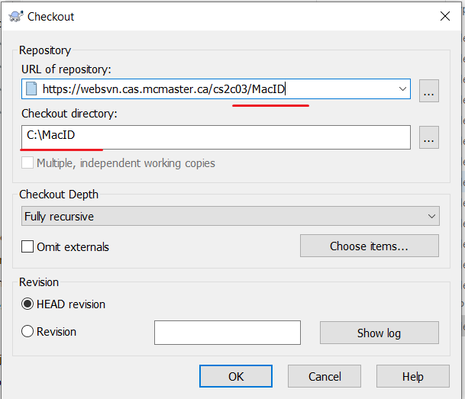
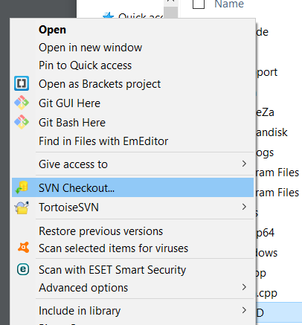
Windows

Slide 7
Add New File
MacOS and Linux
Svn add file-name
Windows
Right Click on the file and choose “TortoiseSVN -> Add”.
Important: After the file has been added to the repository, the file HAS NOT been uploaded to the server. You MUST commit your local working copy.

Slide 8
Commit Local Working Copy
MacOS and Linux
Svn commit –m “your comment”
Windows
Right click on the folder/file and choose “SVN commit”
Important: You MUST commit your working copy after modification

Slide 9
Retrieve Files from Repository
MacOS and Linux
Svn up
Windows
Right click on folder and choose “SVN update”

Slide 10
Check Differences
MacOS and Linux
Svn st
Windows
File icons

Slide 11
Common Mistakes
Forgot to commit!
Always check the differences between your local copy and the server’s
Check the weblink to see your files there:
https://websvn.cas.mcmaster.ca/cs2c03/YOUR_MacID

Slide 12
Big-Oh Notation Definition
Given functions f(n) and g(n), we say that f(n) is O(g(n)) if there are positive constants c and n₀ such that f(n) ≤ cg(n) for n ≥ n₀
Example: 2n + 10 is O(n)
2n + 10 ≤ cn
(c − 2) n ≥ 10
n ≥ 10/(c − 2)
Pick c = 3 and n₀ = 10
Credit: Olga Veksler, UWO canada

Slide 13
More Examples
Example: the function n² is not O(n)
n² ≤ cn
n ≤ c
The above inequality cannot be
satisfied since c must be a constant
 | f(n) is O(g(n)) | g(n) is O(f(n))
g(n) grows more | Yes | No
f(n) grows more | No | Yes
Same growth | Yes | Yes

Slide 14
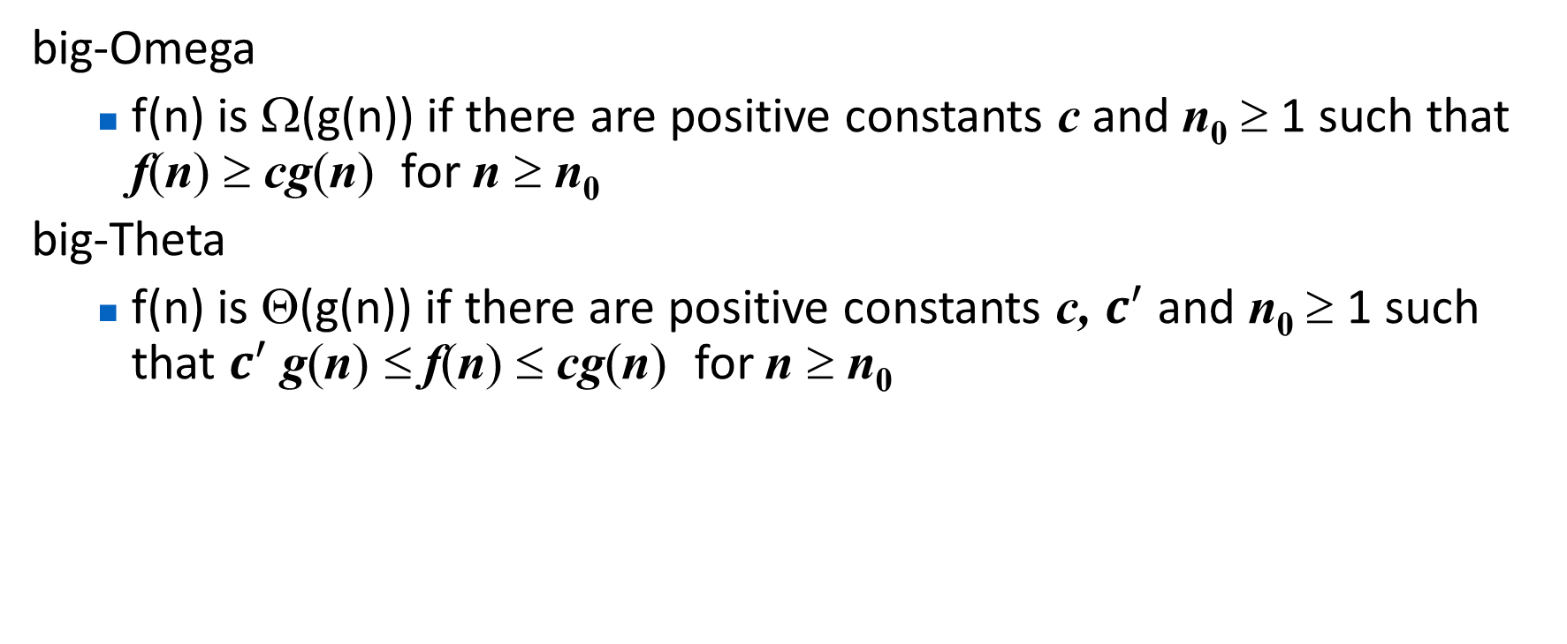
Related to Big-Oh
big-Omega
f(n) is Ω(g(n)) if there are positive constants c and n₀ ≥ 1 such that f(n) ≥ cg(n) for n ≥ n₀
big-Theta
f(n) is Θ(g(n)) if there are positive constants c, $c^{′}$ and n₀ ≥ 1 such that $c^{′}$g(n) ≤ f(n) ≤ cg(n) for n ≥ n₀

Slide 15
More Examples
5n² is Ω(n²)
f(n) is Ω(g(n)) if there is a constant c > 0 and an integer constant n₀ ≥ 1 such that f(n) ≥ c•g(n) for n ≥ n₀
let c = 5 and n₀ = 1
5n² is Ω(n)
f(n) is Ω(g(n)) if there is a constant c > 0 and an integer constant n₀ ≥ 1 such that f(n) ≥ c•g(n) for n ≥ n₀
let c = 1 and n₀ = 1
5n² is Θ(n²)
f(n) is Θ(g(n)) if it is Ω(n²) and O(n²). We have already seen the former, for the latter recall that f(n) is O(g(n)) if there is a constant c > 0 and an integer constant n₀ ≥ 1 such that f(n) < c•g(n) for n ≥ n₀
Let c = 5 and n₀ = 1

Slide 16
Important Functions Growth Rates
n | log(n) | n | nlog(n) | n² | n³ | 2^{n}
8 | 3 | 8 | 24 | 64 | 512 | 256
16 | 4 | 16 | 64 | 256 | 4096 | 65536
32 | 5 | 32 | 160 | 1024 | 32768 | 4.3x10⁹
64 | 6 | 64 | 384 | 4096 | 262144 | 1.8x10¹⁹
128 | 7 | 128 | 896 | 16384 | 2097152 | 3.4x10³⁸
256 | 8 | 256 | 2048 | 65536 | 16777218 | 1.2x10⁷⁷

Slide 17
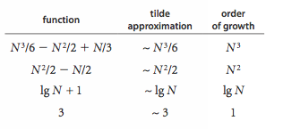
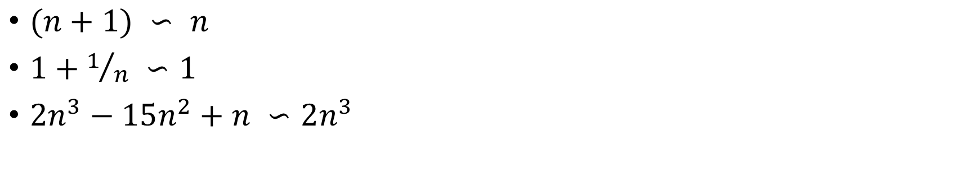
Tilde Approximation vs Order of Growth
$(n+1) ∽ n$
$1+1/n ∽1$
$2n^{3}−15n^{2}+n ∽2n^{3}$

Slide 18
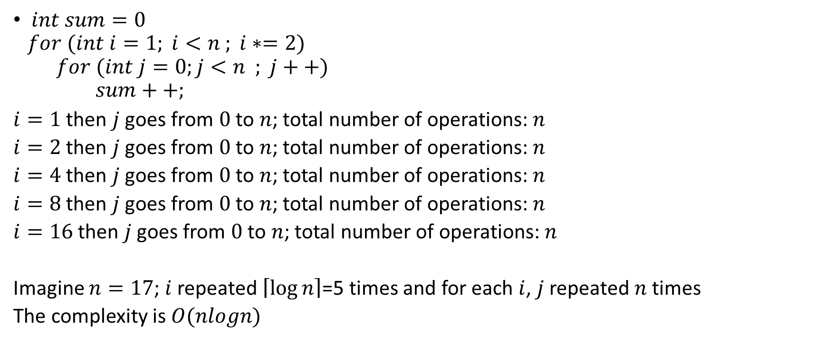
Complexity example
$int sum=0$
$$for (int i=1; i<n ; i∗=2)$$
$$for (int j=0;j<n ; j++)$$
$$sum++;$$
$i=1$ then $j$ goes from $0$ to $n$; total number of operations: $n$
$i=2$ then $j$ goes from $0$ to $n$; total number of operations: $n$
$i=4$ then $j$ goes from $0$ to $n$; total number of operations: $n$
$i=8$ then $j$ goes from $0$ to $n$; total number of operations: $n$
$i=16$ then $j$ goes from $0$ to $n$; total number of operations: $n$
Imagine $n=17$; $i$ repeated $\left\lceil \log{n}\right\rceil$=5 times and for each $i$, $j$ repeated $n$ times
The complexity is $O(nlogn)$

